Slide 1
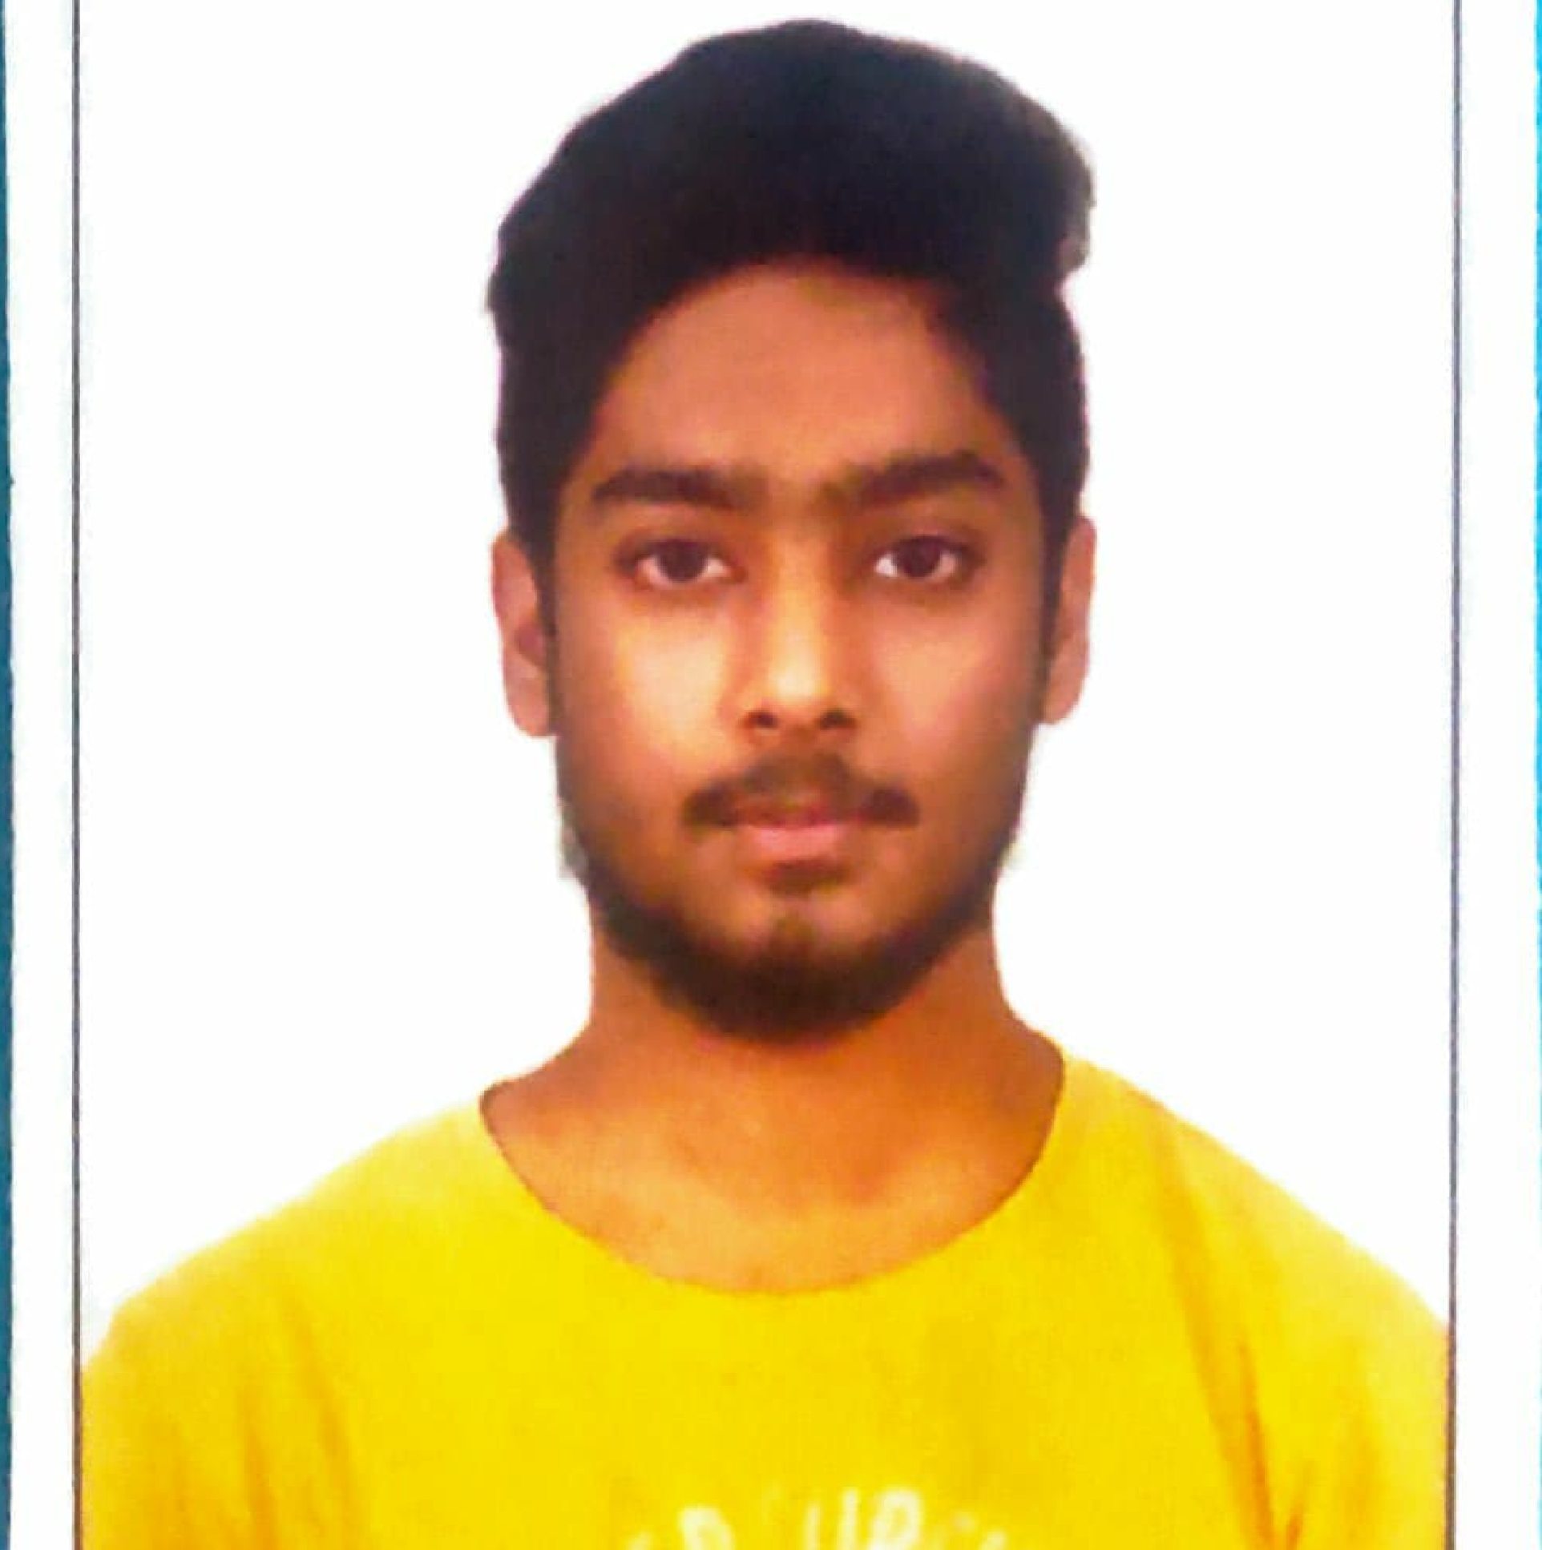



Akhil Reddy Palakala
Analyst
CSE, Bachelor of Technology
Computer Science : 2018 - 2022
Skills:
Bangalore
Java 8 /J2EE | Java Basics, OOPS, Generics, Collections, Arrays, Loops, Lambda Exp, Stream API Junit, Mockito, Servlets
Spring core | IOC & Dependency Injection, Autowired
Spring REST | REST controllers, Implementation of GET, POST, PUT & DELETE, Bean Validation & Exception Handling, Testing Services, Controller & Repository layer
Spring Boot Microservices | Spring Boot Starters, annotations, Messaging Service, Sync/Async comms, Swagger API documents
Spring Cloud | Eureka, Netflix Ribbon, Feign Client, Netflix Hystrix, cloud gateway & Config Server
Angular | Components, Services, Modules, Routing, Forms & Validation, Testing using Jasmine & Karma
Database | MongoDB No Sql Basics My SQL RDS Basics
UI Tech | HTML 5 & CSS 3,JavaScript, ES6 & TypeScript Reusable templates, Optimized UI Designed
Tools | Git, Postman, Maven, Spring STS, Sonarqube
Add On skills | Communications, Team management. Peer learning
palakala-akhil.reddy@capgemini.com
+91 9381063316
A4
Full Stack Developer
Hands on experience in creating multiple microservices with Spring boot, Spring Security, Spring Cloud API Gateway, Eureka server, resilience 4J, load balancing
Proficient in creating Single page Web Application in Angular with Authentication with route guards, Angular reactive forms, angular routing, CSS, HTML ,Angular Material
Hands on experience in implementing noSQL with NodeJs & spring boot
Experience in creating documentation with Java docs and swagger and in unit testing using Junit, Mockito including code quality compliance using Sonarqube
For documentation of microservice, Used Swagger
For noSQL database ,Used MongoDB
E-Commerce Shopping Cart Application
Completed end to end case study of Shopping Cart Application along with JWT authentication, Swagger , Sonarqube , payment testing using Gpay, responsive UI with CSS, HTML and Angular used for user interface.
I have used 5 microservices along with API Gateway, Eureka Discovery Server.
For id’s like productId, cartId , orderId I have implemented Auto-ID Generator.
RestTemplate for intercommunication between microservices
Check out my work on GitHub & Video Profile

